Slide 1


Slide 2

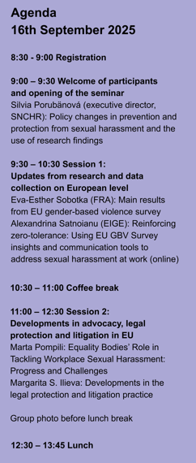
Agenda
Day 1: 16th September 2025
9:00 – 9:30 Welcome of participants and opening of the seminar
9:30 – 10:30 Session 1: Updates from research and data collection on European level
10:30 – 11:00 Coffee break
11:00 – 12:30 Session 2: Developments in advocacy, legal protection and litigation in EU
Group photo before lunch break
12:30 – 13:45 Lunch

Slide 3
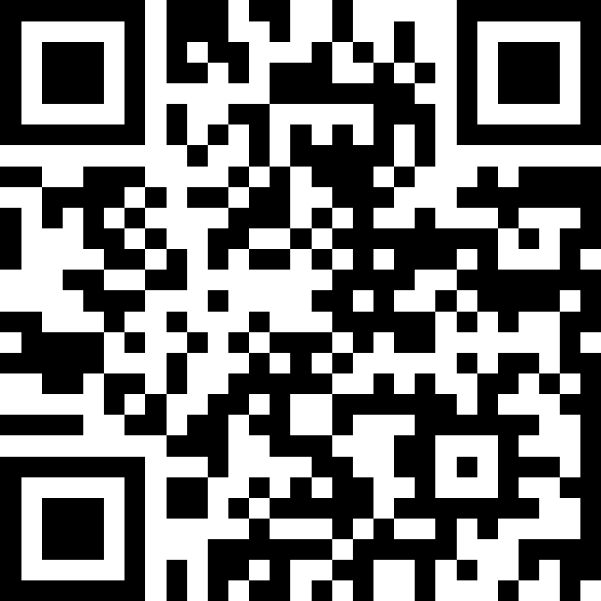
Agenda
Q&A
slidocom
#1039 482

Slide 4
Agenda
13:45 – 15:00 Session 3: Research of sexual harassment and disparities of legal definitions
workshop and facilitated discussion

Slide 5
Agenda
15:30 – 17:30 Session 4: Methods and data collection for international empirical research, panel discussion facilitated by Daniel Gerbery
Vilana Pilinkaite Sotirovic (Lithuanian Social Science Centre)
Conducting a survey on gender-based violence in academia: Lessons learned from the H2020 UniSAFE project
Nuno Rebelo dos Santos (University of Evora) & Leonor Pais (University of Coimbra)
Decent Work and Gender-Based Violence and Harassment: Development of questionnaires for international research.
Kristina Gotthardová (CELSI)
Methodological challenges for comparative international research of sexual harassment in the workplace

Slide 6
Agenda
Day 2: 17th September 2025
9:00 – 9:45 Session 5: Perspectives of national research reports on sexual harassment at workplace
9:45 - 11:00 Session 6: Summary of Day 1 and recommendations for the work of expert group (facilitated discussion)
11:00 – 11:15 Coffee break / Lunch
Follow-up programme for the Expert Group of the VIOLET consortium
11:15 – 13:30 Session 7: Launch of the research project activities
13:45 Wrap-up and Lunch

Slide 7
Agenda
9:00 – 9:45 Session 5: Perspectives of national research reports on sexual harassment at workplace
Dace Cālīte (Public Defender of Rights Latvia)
Sexual Harassment in Latvian Universities 2024/2025 – Main Findings
Alma Lahe (Together for Life)
Ensuring Inclusiveness and Reliability in Researching Workplace Sexual Harassment: The Albanian Case
Maria do Rosário Fidalgo (CITE)
CITE's intervention in preventing and combating harassment at work in Portugal
Michaela Ujházyová (SNCHR)
Sexual harassment in the sector of healthcare

Slide 8
Agenda
Q&A
slidocom
#1039 482

Slide 9
Agenda
9:45 - 11:00 Session 6: Summary of Day 1 and recommendations for the work of expert group (facilitated discussion)
Information about available data (EU-GBV), EU legislation, advocacy
Proposals/recommendations related to data gaps, comparability
Examples of research designs, methodology of developing surveys, challenges of international research
Supra-national legal norms and definitions of SH (as GBV)

Slide 10
Agenda
Empirical research / research of prevalence – general recommendations:
- Gender identity - self-identification of respondents;
Intersectionality – type of contract, sexual orientation, migrant background, ethnicity/nationality, disability;
(under)reporting – barriers and sensitivity
action taken based on reporting – effective protection of victim´s rights, retaliation – focus on obligations of states and employers, role of other actors.

Slide 11
Agenda
Empirical research / research of prevalence – general recommendations:
- Complexity of incidents – what are the conditions – where it happens, with/without bystanders,
Information about victims and perpetrators
Broader theoretical concepts of SH – findings „translated“/interpreted in the context of legal framework „not just monitor problem but make data useful for politicy recommendations“

Slide 12
Agenda
Empirical research / research of prevalence – development of the tool:
peer-reviewed process
diverse pool of experts – national/cultural, professional
several rounds of testing/piloting
standardized process of testing translations

Slide 13
Agenda
Empirical research – added value of sector-based research:
test the hypoteses about horizontal and vertical / power dynamics at the workplace;
test the hypoteses about the factor of gendered workplace/sector (female/male sectors);
focus on preventive measures and the role of sectoral institutions (e.g. trade unions, professional organisations);
more accurate „profiles“ of victims and perpetrators – vulnerability within sector.

Slide 14
Agenda
Q&A
slidocom
#1039 482

Slide 15
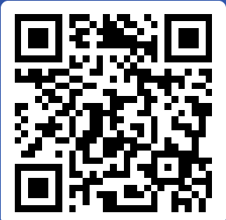
Agenda
Theoretical construct of SH – legal vs/and sociological/social-science
Transnational norms provide basis for broader understanding
Concept of SH as form of discrimination is not sufficent – GBV allows broader understanding
slido.com
#1023 312

