Slide 1
Towards the toolkit for SH research
From Insight to Impact. New Directions in Sexual Harassment Research, 17.09.2025

Slide 2
Session's schedule:
infopack about the toolkit, discussion
group work on methodological questions (legal analysis and empirical research)
reporting of the results
division of work

Slide 3
Objective of the toolkit
ensure higher comparability of data from national research studies
enable equality bodies outside project consortium to implement similar research in their national contexts

Slide 4
Proposed structure of the toolkit:
Definition of the sexual harassment as a subject of the research
Design of the research
Questionnaire items with guidance for national and contextual adaptations
Recommendations for management of data quality
HRBA guidance

Slide 5
1. Definition of the sexual harassment as a subject of the research
1.1 Legal framework
          comparison of national legal definitions
  assessment of transposition/ratification of transnational legal norms
1.2 Social concepts used in empirical research
1.3 Comparison
identification of behaviour/situations which will/will not be covered by legal analyses and/or by empirical research

Slide 6
2. Design of the research
aims of the research
research questions
timescope
what and how - methods and subject matter of legal analyses and research of prevalence

Slide 7
3. Questionnaire items with guidance for national and contextual adaptations
items structured according to modules (prevalence, impact, reporting and institutions, awareness and sensitivity)
variants for different sectors when necessary
voluntary/additional items

Slide 8
4. Recommendations for management of data quality
ensuring representative sample for the selected sector of employment
managing bias of respondents who are more sensitive towards sexual harassment
encouraging reliable responses

Slide 9
First draft | Internal comments | Pilot of questionnaire items | Finalization of text | Graphic layout of publication/upload to reporting
Chapter 1+2 31.10.2025 Chapter 3+4 30.11.2025 | November-December 2025 December- January 2026 | 20.1.2026 | 31.1.2026 | 28.2.2026

Slide 10
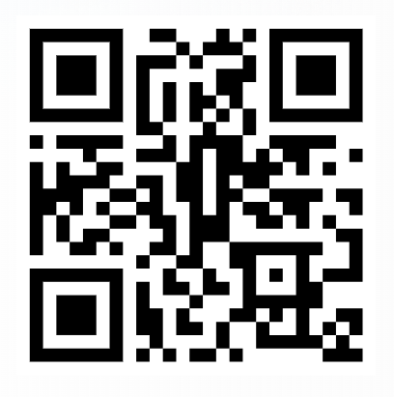
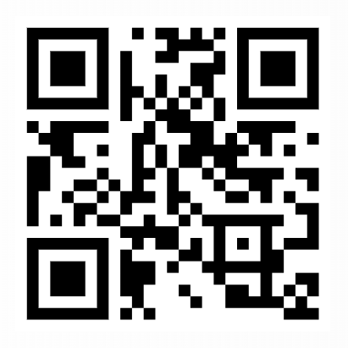
Legal analysis notes
Empirical research notes

Slide 11

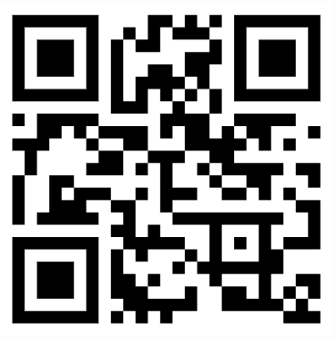
workplan

Slide 12
Time for your questions!

