Slide 1


Slide 2

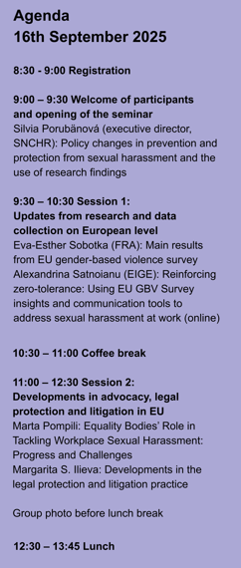
Agenda
Sexual harassment in the sector of healthcare in Slovakia
Michaela Ujházyová
Slovak National Center for Human Rights
Notes:
In the following presentation I will talk about the research of SH in the sector of healthcare – basic information about the design, theoretical framework we used and some of the findings of the research

Slide 3
Agenda
ENNHRI regranting project: Collecting data about sexual harassment for advocacy and reporting to regional mechanisms by NHRIs (SGA-CERV-2023-07)
Research objectives
gain knowledge about the prevalence of sexual harassment at the workplace;
identify potentially vulnerable groups of staff and risk situations;
assess staff sensitivity to harassing behaviour.
Notes:
Slovak national center for human rights conducted this research within the regaranting scheme of ENNHRI with the aim to use the findings in our reporting and advocacy activities as NHRI. Main objectives of the research were to gain knowledge about the prevalence of SH, identify potentially most vulnerable groups and situations at work which increase the risk of SH, assess staff sensitivity towards harassing behaviour.

Slide 4
Agenda
Data collection:
between July and October 2023
directly at workplaces (38 healthcare facilities), coordinated with support of the Ministry of Healthcare of SR
45 381 employees in health care – including non-medical professions, all forms of employment;
1,814 responses (1387 for analysis) – representative sample by region, type of the facility, profesion, gender, age
Notes:
Research was conducted between July and October 2023 at 38 workplaces – hospitals, sanatoriums, public health organisations – approached through the Ministry of Healthcare of SR.
There are about 45 500 employees in health care sector, out of which we collected 1800 responses, the final sample was representative according to distribution of employees among regions, types of organisations, profession categories, gender and age.

Slide 5
Agenda
Classification according to the Sexual Experience Questionnaire (Fitzgerald, Gelfand, & Drasgow, 1995):
Gender-based harassment
Unwanted sexual attention
Sexual coercion
Legal framework:
Anti-discrimination law:
sexual harassment as a form of discrimination
discrimination in employment – responsibility of employer
harassment
Criminal code:
sexualised violence, rape, dangerous stalking
Notes:
As the main theoretical construct of experience of sexual harassment we worked with the SEQ developed and tested by Fitzgerald and her colleagues in US in 80s and 90s, or rather with a revised for the use at workplace, which distinguishes three categories of behaviour – gender-based harassment, unwanted sexual attention and sexual coercion.
This understanding of SH includes situations which go beyond the definition of SH within Slovak national law. – it includes discrimination in employement based on gender, harassment but also sexualised violence, rape, dangerous stalking.
Legal framework also guided us in decisions about including all gender victims, definition of employment, information about perpetrators, awarness of available protective measures...

Slide 6
Agenda
 | Have you experienced the following situations at your healthcare workplace in the last ten years? | Potential fulfillment of the factual basis of legal def.
gender based harassment | 1. Someone told jokes or stories with sexual undertones that made you uncomfortable. | sexual harassment
 | 2. Someone made sexist remarks disparaging men or women in general. | harassment
 | 3. Someone disadvantaged you because you are a woman/man. | discrimination based on gender
 | 4. Someone in your presence displayed sexually explicit material unrelated to work, causing discomfort. | sexual harassment
 | 5. Someone made an annoying comment about your appearance being attractive/unattractive. | harassment; sexual harassment
Notes:
To bridge the difference between the understanding of sexual harassment by theory we used for operationalization and by legal framework we have included matrix which specifies whether the situation would potentially met the definition of sexual harassment or rather different breach of law.

Slide 7
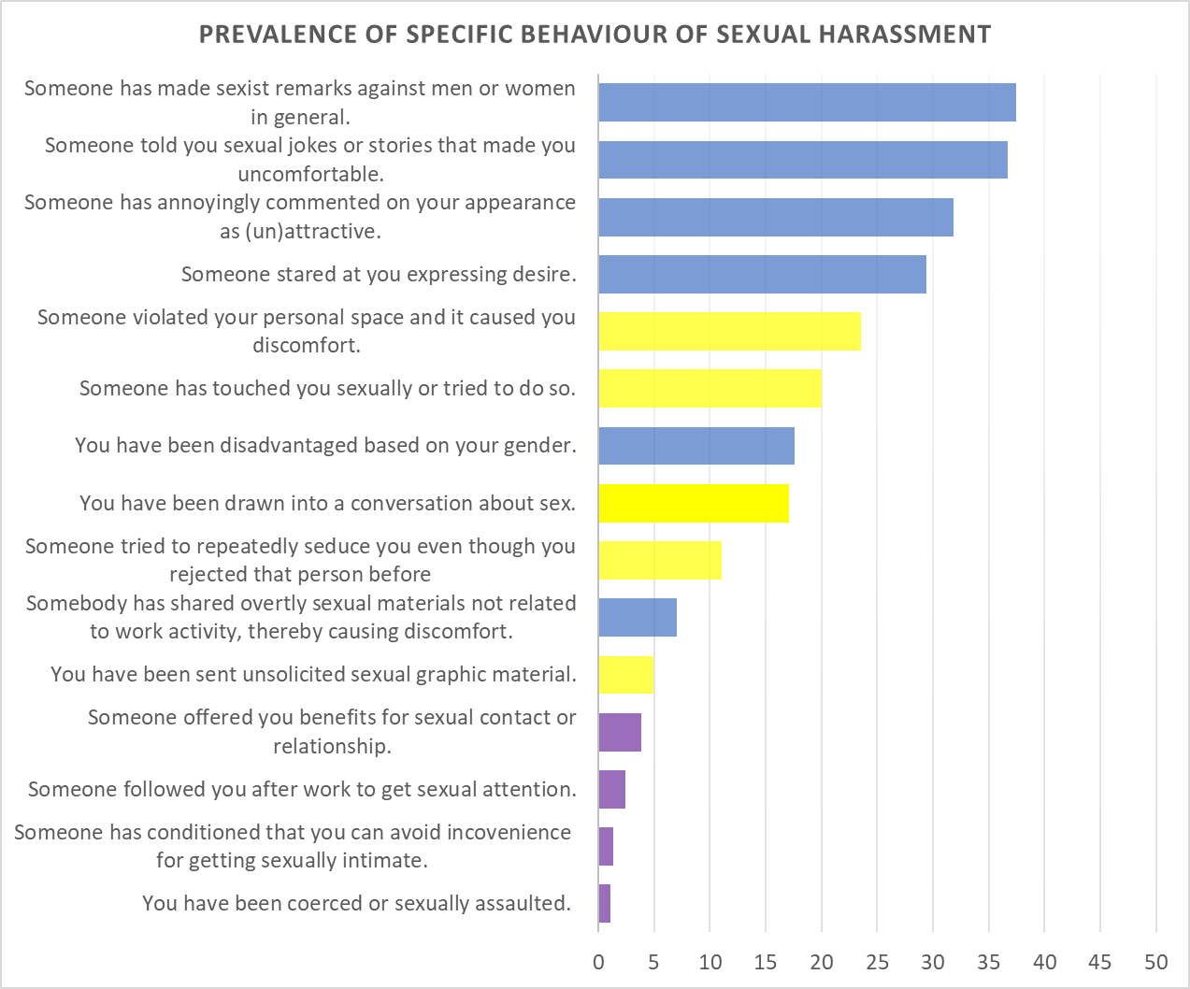
Agenda
The most common forms (37%) of harassment are general sexist comments and stories with sexual connotation.
Every second person working in healthcare has encountered gender-based harassment and/or unwanted sexual attention.
6% of staff have encountered some form of sexual coercion.
Notes:
The graph visualises prevalence of sexual harassment, color-coded according to the cluster and ranked according to the prevalence of individual items.
The most common are verbal forms of harassment such as sexist comments, jokes and stories. Followed by comments about appearance.
Every second person has encountered some form of gender-based harassment or unwanted sexual attention (blue/yellow) - more than 50% of respondents confirmed that they had encountered at least one situation described in the cluster once or repeatedly.
6% of staff have encountered at least one form of sexual coercion, with more than 1% experiencing sexual violence or attempted sexual assault.

Slide 8
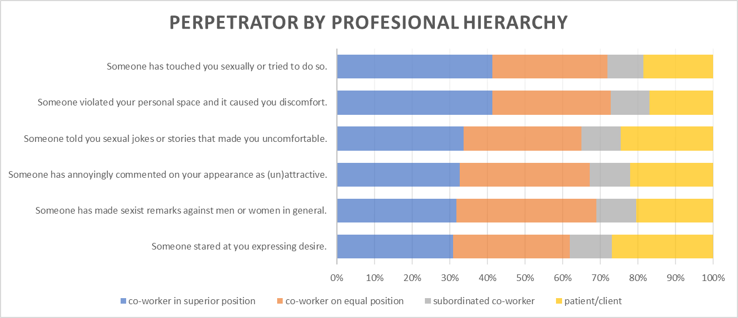
Agenda
Notes:
Findings confronting the stereotypical image of a patient harassing (or joking around) a nurse show that most common perpetrators are co-workers in superior positons or equal positions.
These findings are very useful for advocacy and preventive work at individual workplaces because they show that:
Sexual harassment is happening within teams – therefore measures oriented internally are necessary
Confirmes that SH is experienced also from patients and there should be some protective measures and information campaignes oriented towards public/patients

Slide 9
Agenda
Other findings to point out:
10 % of resp. experienced some forms of SH during atestation/internship
most frequent SH takes place in front of other people (staff, patients)
1 % of respondents reported/consulted their cases
relativisation of the severity/impact of experienced SH
low awareness about protective measures, role of EB and other actors

Slide 10
Agenda
Limitations of research
Understanding of challenges to reporting and what action is taken after reporting
Gender of perpetrators
Indication of vulnerability of a group of employees based on prevalence – impact of lower sensitivity/high normalisation of sexualisation
More complex/accurate understanding of the level of awareness

Slide 11
Agenda
Thank you for your attention
facebook.com/StrediskoPreLudskePrava
instagram.com/StrediskoPreLudskePrava
www.snslp.sk

