Slide 1




CITE'S INTERVENTION IN PREVENTING AND COMBATING HARASSMENT AT WORK IN PORTUGAL
17/09/2025 | Bratislava Maria do Rosário Fidalgo | Portugal

Slide 2


Tripartite composition
Confederations
1 | Confederation of Tourism of Portugal | CTP
1 | Confederation of the Portuguese Farmers | CAP
1 | Confederation of the Portuguese Industry | CIP
1 | Confederation of Commerce and Services of Portugal | CCP
Governance
1 | Ministry of Labour Solidarity and Social Security
1 | Ministry responsible for Gender Equality
1 | Ministry responsible for the Public Adminstration
Syndicates
2 | General Confederation of the Portuguese Workers | CGTP-IN
2 | Workers General Union | UGT

Slide 3
CITE´s Mission
Promote equality and non discrimination between men and women in labour, employment and vocational training.
Collaborate in the implementation of legal provisions and conventions on equality and non-discrimination between men and women in labour, employment and vocational training, as well as those concerning the protection of parenthood.
Promote Work-life balance in the private, public and cooperative sectors.

Slide 4
Sexual and Moral Harassment in the Workplace– CITE’s Duties
Issue legal opinions on Sexual and Moral Harassment in the Workplace
Information requests 2024 | Complaints
5 women 0 men | 0
Information requests 2023 | Complaints
14 women 8 men | 0

Slide 5

Sexual and Moral Harassment in the Workplace Training
The content:
The Commission for Equality in Labour and Employment
Portuguese, EU and international legislation
Data on Sexual and Moral Harassment in the Workplace
National campaigns to combat Sexual and Moral Harassment in the Workplace in Portugal
Target:
Employers' representatives
Trade Unions
Society and others

Slide 6

Number of training Sexual and Moral Harassment in the Workplace 2021-2025

Slide 7
Number of training Sexual and Moral Harassment in the Workplace 2021-2025
Percentage of trainees in training courses on harassment, broken down by gender between 2021 and 2025
(1st semester)

Slide 8
NATIONAL CAMPAIGNS

Slide 9
Zero Tolerance to Workplace Harassment Campaign
CITE conducts annual awareness and training sessions on workplace harassment, including the "Zero Tolerance to Workplace Harassment" campaign and sessions for employers, universities, and other entities.
These activities aim to foster a zero-tolerance culture towards harassment.

Slide 10





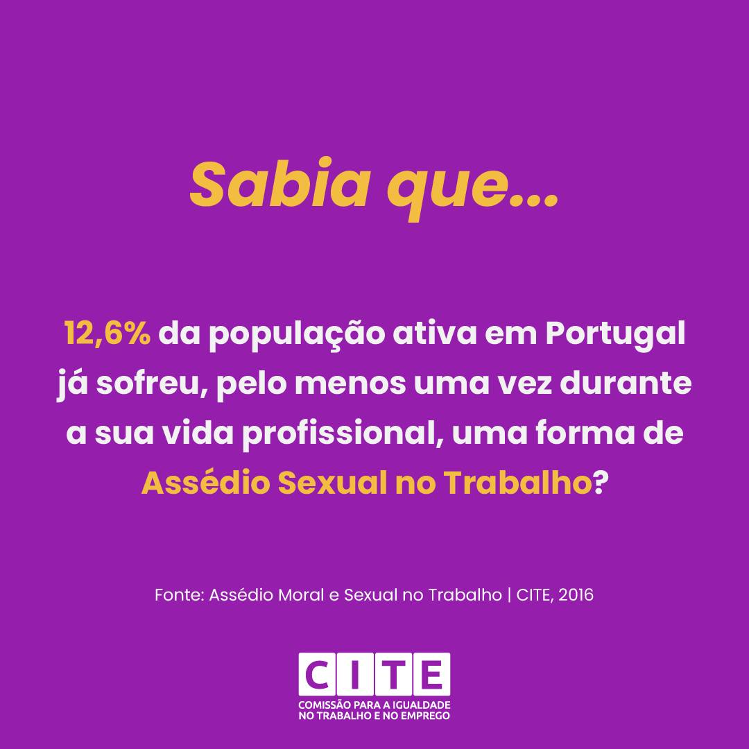
Awareness-raising campaigns

Slide 11
Sexual and Moral Harassment in the Workplace, project funded by the European Economic Area (EEA) Grants, specifically Programme PT 07 – Integration of Gender Equality and Promotion of Work-Life Balance.

Slide 12




Sexual and Moral Harassment in the Workplace, project funded by the European Economic Area (EEA) Grants, specifically Programme PT 07 – Integration of Gender Equality and Promotion of Work-Life Balance.

Slide 13
Sexual and Moral Harassment in the Workplace
Developed by the Commission for Equality in Labour and Employment (CITE) and conducted by the Interdisciplinary Centre for Gender Studies (CIEG), the project provided a comprehensive diagnosis of harassment in the Portuguese labour market.
The project involved a comprehensive study to diagnose and characterize harassment in the Portuguese labour market. It raised awareness through a questionnaire survey and interviews, leading to valuable outputs like a training manual and a detailed study on harassment's prevalence and characteristics.

Slide 14
Sexual and Moral Harassment in the Workplace
Building on a pioneering 1989 study, the updated investigation broadened its scope to include the women and men as potential victims and, for the first time, addressed moral harassment in addition to sexual harassment.
Data were collected through a 2015 survey of the Portuguese active population, complemented by in-depth interviews with victims.
Findings revealed that harassment prevalence in Portugal remained above the European average, with 12.6% reporting experiences of sexual harassment (8.6% men|14.4% women) and 16.5% reporting moral harassment (15.9% men|16.7% women).

Slide 15
Sexual and Moral Harassment in the Workplace
The research established clear definitions and typologies. Moral harassment was categorized into social isolation, professional persecution, intimidation, and personal humiliation, whereas sexual harassment encompassed unwanted sexual attention, coercion, and gender-based harassment.
Perpetrators were most often superiors or direct managers, particularly in moral harassment (over 80% of cases), and men were found to account for the majority of moral harassment incidents (69.7%). These dynamics reflected entrenched power imbalances and broader social inequalities.

Slide 16
Conceptual framework
Harassment Moral is considered moral when it consists of verbal attacks of an offensive or humiliating nature, physical attacks, or more subtle acts, which may include physical and psychological violence, aimed at diminishing the victim's self-esteem and, ultimately, their connection to the workplace.
Harassment is sexual when the aforementioned unwanted behavior, whether verbal or physical, is of a sexual nature. Specifically: invitations of a sexual nature, sending messages of a sexual nature, attempts at embarrassing physical contact, blackmail to obtain employment or career advancement in exchange for sexual favors', obscene gestures.
Harassment

Slide 17
Sexual and Moral Harassment in the Workplace
Certain groups were identified as particularly vulnerable, including younger individuals, people in precarious employment, and those at early career stages. Small and micro-enterprises where harassment is harder to confront, due to resource limitations and close interpersonal ties.
The consequences for victims were severe, affecting physical and psychological health. A recurrent reaction was passive endurance of the situation, often linked to fear of professional retaliation or lack of trust in legal redress mechanisms.

Slide 18
Legislation on Sexual and Moral Harassment in the Workplace in Portugal
This context must be understood in light of the Portuguese and European legal framework. In Portugal, the Labour Code (Law no. 7/2009, as amended) explicitly prohibits harassment in the workplace (Article 29) and establishes employer responsibility for prevention.
The Law no. 73/2017 further strengthened protection by requiring companies with seven or more employees to adopt codes of good conduct and by mandating disciplinary proceedings when harassment is suspected. Additionally, the Portuguese Criminal Code criminalizes certain forms of sexual harassment, including coercion and unwanted sexual advances (DL n.º 400/82, de 23 de September and DL n.º 48/95, 15 March (article 154.º-A).

Slide 19

Guide for the development of a code of good conduct to prevent and combat workplace harassment
The CITE promoted the creation of the guide "Guide for the development of a code of good conduct to prevent and combat workplace harassment." This instrument supports companies in complying with the new provisions regarding sexual harassment, introduced into the Portuguese Labour Code by Law No. 73/2017 of August 16. The law strengthened the legislative framework to prevent workplace harassment, applicable to the private and public sectors.
Impact: CITE’s efforts contribute to the effective implementation of legislative measures designed to prevent and combat harassment, ensuring that employers understand and fulfill their legal obligations.

Slide 20
Sexual and Moral Harassment in the Workplace
The results of Project VIOLET - TOWARDS WORKPLACES WITHOUT SEXUAL HARASSMENT AND VIOLENCE are expected to drive significant policy changes, leading to the creation of safer and more inclusive workplaces.
By addressing the root causes of gender-based violence and promoting best practices, CITE can foster a culture of respect and equality, ensuring that all employees can work without fear of harassment or discrimination.
Their involvement the importance of addressing intersectional issues in the fight against workplace inequalities.

Slide 21
Sexual and Moral Harassment in the Workplace
CITE reaffirms its commitment to promoting training programs and awareness campaigns on workplace harassment, aimed at employers and their employees, encouraging a culture of respect, decent work, safety, equality, and non-discrimination, with the goal of creating and free of violence and non-discrimination between women and men.

Slide 22
Thank you for your attention
Rua Américo Durão, 12 A – 1.º e 2.º piso 1900-064 Lisboa
(+351) 215 954 000 geral@cite.pt

