Slide 1



Ensuring Inclusiveness
and Reliability in Research: Sexual Harassment
at Workplace
THE ALBANIAN CASE

Slide 2





(i) Labour Code;
(ii) Law on Protection from Discrimination;
Albania legal framework:
(iii) Law on Gender Equality;
(iv) Code of Administrative Procedures.
Notes:
Albania has taken legal and institutional measures to prevent, treat and punish SH based on international legal standards expressed in Conventions of UN and those of Council of Europe and European Union.
There is wide framework of legal standards, the implementation of which is obligation for state, public and private institutions

Slide 3


(i) To understand the types, prevalence, and exposed subjects;
Why
a national study?
(ii) To comprehend the beliefs, cultural norms, gender stereotypes, and biases that favor sexual harassment at work.
Notes:
The study documents the perceptions, experiences and attitudes of workers.

Slide 4


REPORT
SEXUAL HARASSMENT IN THE WORKPLACE
  provides an overview of public perceptions about the protection of employees' rights in Albania;
  highlights the opinions and experiences of employees who are currently employed in the public and private sectors.
Notes:
- ... rights in Albania...
including insights into the influence of laws, policies, cultural norms, and social attitudes related to sexual harassment.

Slide 5








Definition
Study uses the definition of Labor Code for SH as an unwanted sexual behavior that manifests itself through:
  physical contact and touching;
  sexually nuanced expressions,
  the display of images with sexual content;
  requests for sex through words and actions.

Slide 6


Metodology
Quantitave study
Online quantitave survay:
- 1026 successful interviews in urban areas;
- Period: March 19 – April 30, 2023
- Gender segments: Men 55% and Women 45%
- Sample weights: Public sector 26% and Private sector 74%
Notes:
R based on data collected from several sources. It uses a combination of both quantitative and qualitative methods in order to have a clearer picture of SH in the world of labor of Albania.
R combinate data that comes from the primary sources of the quantitative and qualitative study, with secondary data coming from the literature, reports and official sources.
The size and structure of the sample is representative of the labor force in Albania. To ensure a qualitative national urban representation it used quotas for different segments (age, gender, region, type of employment) of the population and the final weighting of the results according to the official data of INSTAT
The study did not focus on specific sectors, but analyzed the prevalence of the phenomenon in the public sector and private enterprises based only on the size of the company and the number of employees.

Slide 7

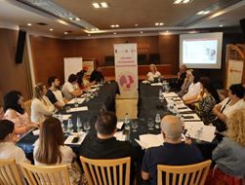
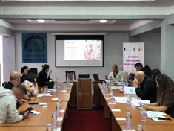
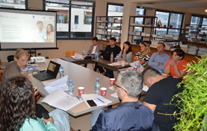
Metodology
Qualitative data
22 in-depth interiews with employees and employers including:
- victims of sexual harassment at work (6 people);
- witnesses (5 people);
- colleagues (5 people);
- employers or administrators (6 people)
Three focus-groups in different regions:
- 15 participants in each meeting;
- representatives from publik and privat sectors.
Notes:
Collecting qualitative data through in-depth interviews and focus groups.
22 interviews were conducted

Slide 8
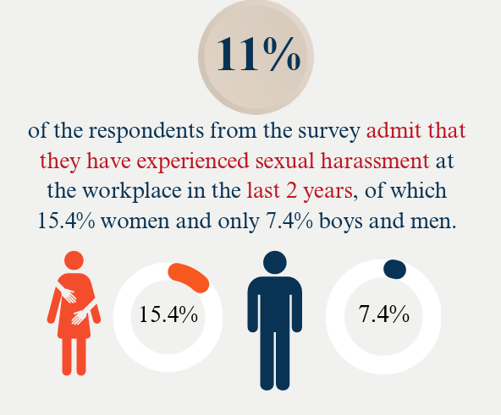
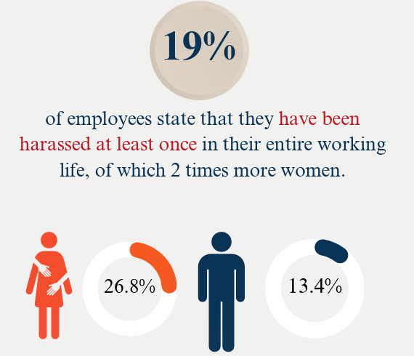
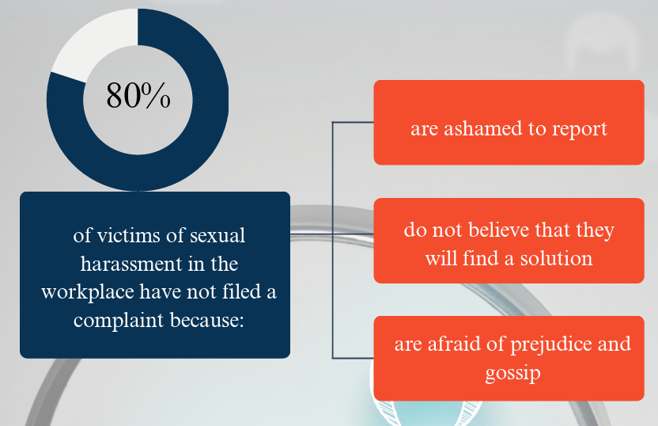
MAIN FINDINGS
The position of the person who have committed the harassment
Female employees that have experienced harassment
58% superior
42% colleague
Male employees that have experienced harassment
17% superior
63% colleague

Slide 9
MAIN FINDINGS
Perspectives on Sexual Harassment in the Workplace
SH at work is
a serious problem in our country
In our society, it is considered shameful to talk about SH
SH in the workplace often goes uninvestigated and unpunished
It is considered inevitable when men and women work together
57%
49%
70%
22%
Notes:
Limited reporting of sexual harassment in the workplace is the result of:
Lack of trust in the management structures of the enterprise/company
The persistence of stereotypes that stigmatize and blame women and girls
Lack of awareness that gender-based violence is not a personal matter, but a violation of human rights

Slide 10



  Recomandations
Criminalization
  based on the type of harassment, its degree of seriousness, physical and health damage of the victim and the hierarchical position of the harasser and the harassed;
  the threat of quid pro quo due to the leadership position, as an aggravating factor for the purposes of imposing a sentence;
  digitalized forms of SH through digital devices.
Media
Training journalists to raise their awareness and improve reporting on cases of SH in the workplace, ensuring coverage does not revictimize the victim.
Training:
  Prosecutors
  Judges
  Public administration
  Employees & employer
Notes:
1) The amendment of legal infrastructure through including forms of SH into penal code:
2) Training on gender-sensitive approaches in dealing with violations related to SH at work, considering it as a form of gender-based violence, to ensure the protection of victims of SH in the Wp and sentencing the abusers.

Slide 11

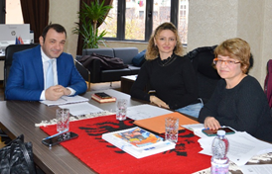
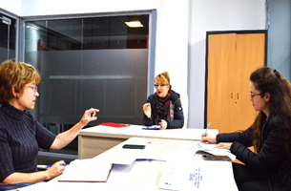

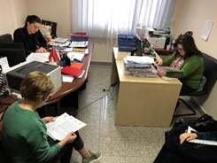
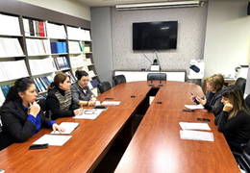

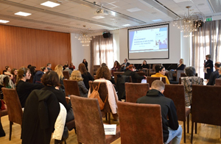

Strategy
for disseminating results
Meetings with institutions
Meetings with responsible institutions:
  Ministry of Health and Social Protection
  The Commissioner for Protection against Discrimination
  Ombudsman
  The Department of Public Administration
  The National Employment and Vocational Training Agency
Round-table
  Sharing the key findings
  Strengthening cooperation between stakeholders
  Improving legislation related to workplace rights
  Enhancing the role of responsible institutions
  Increasing information and awareness
Notes:
Round-table
Sharing the key findings ;
Strengthening cooperation between stakeholders to address challenges;
Improving legislation related to workplace rights and protections;
Enhancing the role of responsible institutions in guaranteeing workers’ rights;
Increasing information and awareness among professionals and the wider public about sexual harassment in the workplace.
Newsletters sent to a list with over 1000 journalists to disseminate the findings of the report.

Slide 12

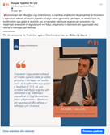
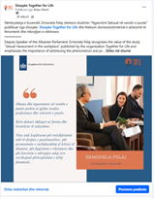

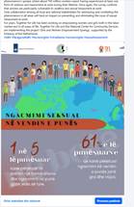


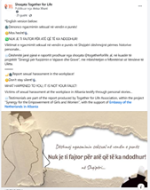
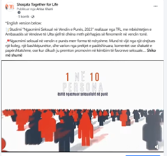
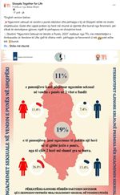


Strategy
for disseminating results
One year of educational and information campaign
The organization of an online campaign through the production and publication on TFL’s social media of:
  12 infographics
  12 photo-messages
  5 short videos
  3 videos, and
  12 media articles

Slide 13


