Slide 1



Sexual Harassment at the Workplace:
Methodological challenges
Kristína Gotthardová
Central European Labour Studies Institute, Bratislava, Slovakia

Slide 2
About the Project:
Sexual Harassment at the Workplace
New evidence and analysis of workplace sexual harassment in Bulgaria, Croatia, Czechia, Greece, Hungary and Slovakia;
Initiated by the Union of Autonomous Trade Unions of Croatia (SSSH) and Friedrich Ebert Stiftung Croatia
Friedrich Ebert Stiftung and CELSI cooperation
Research, policy and advocacy
Recommendations for policymakers, trade unions and employers.

Slide 3
Sexual Harassment at the Workplace: Aims
Improve knowledge about sexual harassment at the workplace and awareness of policies;
Analyse the impact of legal frameworks and "lived practices";
Make policy recommendations;
Develop a training series for union representatives & workers councils.
Added value:
In-depth focus on survivor experiences and needs;
Focus on trade unions.

Slide 4
Time
Short timeline
Budget
Budgetary constraints
Data
Not representative
Key project limitations

Slide 5
Research design and methodology
Challenges and solutions
Survey
Technological limitations
Survivor Interviews
Interview guide with recommended questions
Focus group
Stakeholder diversity
Topic variety
Length and prioritization
Recruitment strategy

Slide 6
Data collection
Challenges and solutions
Survey
Convenience sampling
Interviews
Recruitment difficulties
Focus group
To validate findings
Dissemination strategies
Variety in no. of responses
Unified interview guide
Dependent on national context

Slide 7
Data collection
Sample composition
Data collection
June to September 2024
Sample
Interviews
N = 4,637 survey respondents
44 individual interviews
7 focus groups

Slide 8
Comparative aspects
National analysis
Independent country-level analysis
Integration of all data sources
Challenges
Diverse policy and legislative frameworks
Integration of qualitative data
Comparative report
Integrated data set analysed as one
Inclusion of open-ended questions for context and nuance
Lack of representative data

Slide 9
Key Research Findings
29% respondents experienced SHW
32% of women, 18% of men, young people and women are more vulnerable
Common perpetrators – male colleagues, supervisors, clients
Forms - verbal harassment, unwanted physical contact, coercion and digital harassment
Low formal reporting rates and ineffective responses
Long-term psychological distress and career setbacks

Slide 10
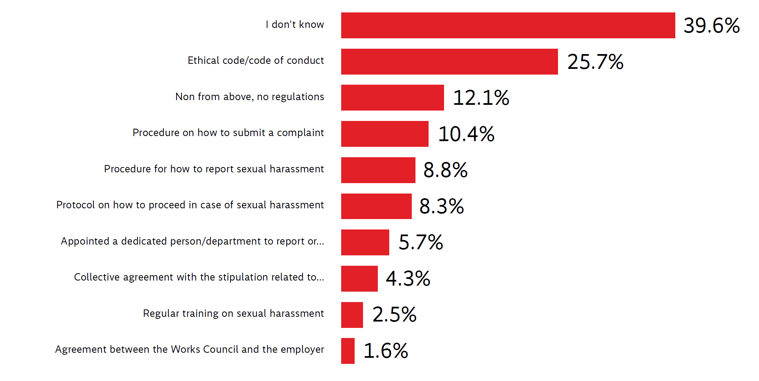
Awareness of workplace SH policies
Question. Does your current employer have any regulations in place to prevent, address, and penalise workplace sexual harassment? If yes, what kind? Please select all applicable options. Note: N = 4637, in percent.

Slide 11
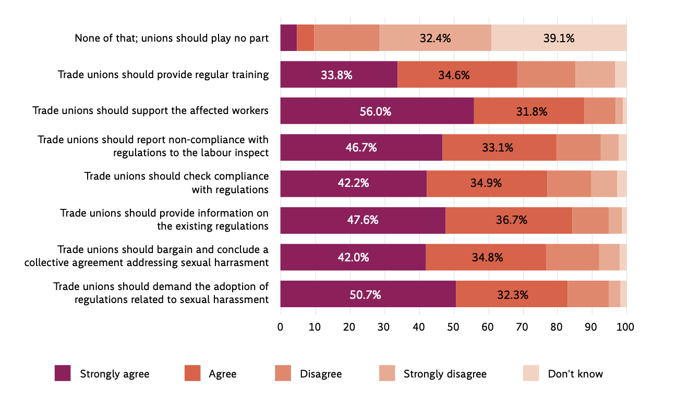
An uncovered potential of trade unions
Question: What role should trade unions play in addressing sexual harassment in the workplace? Please express if you
agree or disagree with each of the roles below. Note: N = 3551, in percent.

Slide 12

Thank you for your attention!
kgotthardova@gmail.com
Reports:
Comparative report: https://library.fes.de/pdf-files/bueros/kroatien/21912-20250424.pdf
National reports – 6 countries: https://www.celsi.sk/en/sexual-harassment-in-the-workplace/

