Slide 1
Expert Seminar
From Insight to Impact: New Directions in Sexual Harassment Research
Bratislava, Slovakia
2025
Decent Work and
Gender-Based Violence and Harassment:
Development of questionnaires for international research
Nuno Rebelo dos Santos
Universidade de Évora
Leonor Pais
Universidade de Coimbra

Slide 2
Other BRAVE-WOW team leaders
Eva Turk
M. Rosário Fidalgo
Inês Saavedra
Marco Giustini
Inés Rey
Anna Carannante
Simona Gaudi
Kika Perez
Paola Bello
Carina Dantas

Slide 3
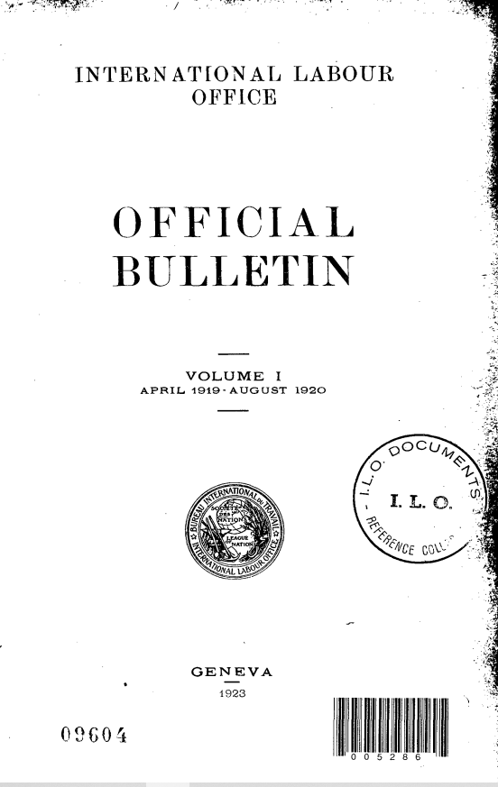
International Labour Organization – 1919
Foundation:
    PART XIII [LABOUR] The Constitution of the International Labour Organisation (pp.227)
    Whereas the League of Nations has for its object the establishment of universal peace, and such a peace can be established only if it is based upon social justice; And whereas conditions of labour exist involving such injustice, hardship and privation to large numbers of people as to produce unrest so great that the peace and harmony of the world are imperilled; and an improvement of those conditions is urgently required…
    The HIGH CONTRACTING PARTIES, moved by sentiments of justice and humanity as well as by the desire to secure the permanent peace of the world agree to the following…
International Labour Office (1920). “Part XIII of the Peace Treaty”. In The Labour Provisions of the Peace Treaties. Geneve. https://www.ilo.org/public/libdoc/ilo/1920/20B09_18_engl.pdf

Slide 4
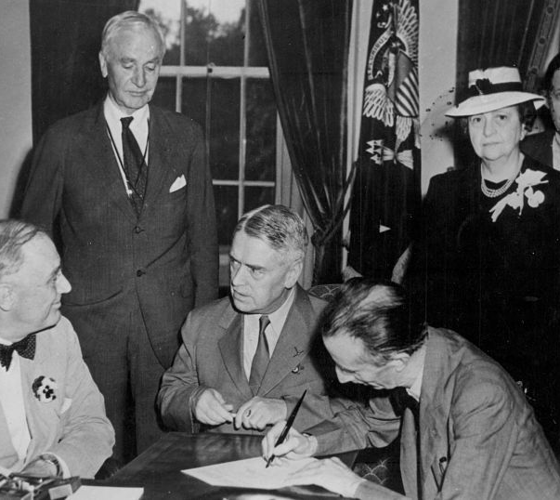
Declaration of Philadelphia – 1944
Reaffirms:
The mission of the International Labour Organization
The centrality of human rights to social policy
The need for international economic planning
Poverty anywhere constitutes a danger to prosperity everywhere
International Labour Organization (1944). ILO Declaration of Philadelphia:
Declaration concerning the Aims and Purposes of the International Labour
Organisation (1944). General Conference of the International Labour Organization.
https://www.ilo.org/static/english/inwork/cb-policy-guide/declarationofPhiladelphia1944.pdf
White House – USA - Edward J. Phelan signing the Declaration of Philadelphia on 17 May1944 at a meeting with President Roosevelt, Secretary of State Cordell Hull, the President of the ILO Philadelphia Conference Walter Nash, US Secretary of Labor Frances Perkins and ILO Assistant Director Lindsay Rogers
https://anciens-bit-ilo.org/wp-content/uploads/2019/07/Edward_Phelan_signe-1.jpg

Slide 5
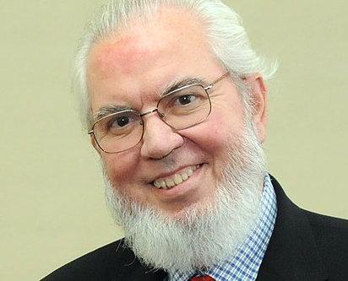
Decent work framework
High legitimacy
Multilevel purpose
  Societal peace promotion
  Organizational sustainability
  Individual wellbeing and development
The primary goal of the ILO today is to promote opportunities for women and men to obtain decent and productive work, in conditions of freedom, equity, security and human dignity (Juan Somavia, ILO Director-General – 1999-2012).

Slide 6
C190 – 2019 – Violence and Harassment Convention
Recognizing that violence and harassment in the world of work can constitute a human rights violation or abuse, and that violence and harassment is a threat to equal opportunities, is unacceptable and incompatible with decent work, (Preamble)
Each member… promote decent work (Article 5)
Each member… shall adopt laws and regulations… provide resources, training, guidance… prevent… gender-responsive… mechanisms… gender-based violence and harassment (Article 7; Article 9; Article 10; Article 11)

Slide 7
Decent Work Questionnaire
Full range of 11 substantive elements
International experts team
  Portugal + Brazil + Spain + Italy + UK + Turkey
  Germany + Indonesia + Slovenia
Initial pool > 100 items
N > 1600 (Portugal + Brazil) =1465 (Italy) =1528 (Spain) = 906 (Turkey)
Exploratory and confirmatory factor analyses
7 dimensions, 31 items
      Çolakoğlu, C., Öz, C.S., Toygar, A. (2024). Psychometric properties of the Turkish version of the Decent Work Questionnaire and its effect on job satisfaction. Work, 78(4), 1055-1067. https://doi.org/10.3233/WOR-230279
      Ferraro, T., Pais, L., dos Santos, N. R. & Moreira, J.M. (2018), The Decent Work Questionnaire: Development and validation in two samples of knowledge workers. International Labour Review, 157: 243-265. https://doi.org/10.1111/ilr.12039
      Ferraro T, dos Santos NR, Pais L, Zappalà S, Moreira JM. (2021). The Decent Work Questionnaire: Psychometric properties of the Italian version. International Journal of Selection & Assessment, 29, 293-302. https://doi.org/10.1111/ijsa.12328
      Ferraro, T., Pais, L., Dos Santos, N. R., Martinez-Tur, V. (2023). The Decent Work Questionnaire: adaptation and validation of the Spanish version. Management Research: The Journal of the Iberoamerican Academy of Management, 21(2), 167–193. https://doi.org/10.1108/MRJIAM-07-2022-1330

Slide 8
Cross cultural issues
The same score may correspond to different objective indicators since cultural differences lead to diverse perceptions
  Overload perceptions between countries where the average working hours vary significantly
  The same comment might be understood as sexual harassment in a low context culture, while in a high context culture, it is not
  The livelihood standard is different between rich and poor countries
  Cultures of low uncertainty avoidance may accept lower standards of health and safety
  High power distance cultures may accept direct instructions without feeling abused, while low power distance cultures may feel direct instructions abusive.
Comparison is made in terms of subjective perceptions
Following the Guidelines of the International Test Commission
  ITC Guidelines for Translating and Adapting Tests (Second Edition). (2018). International Journal of Testing, 18(2), 101–134. https://doi.org/10.1080/15305058.2017.1398166

Slide 9
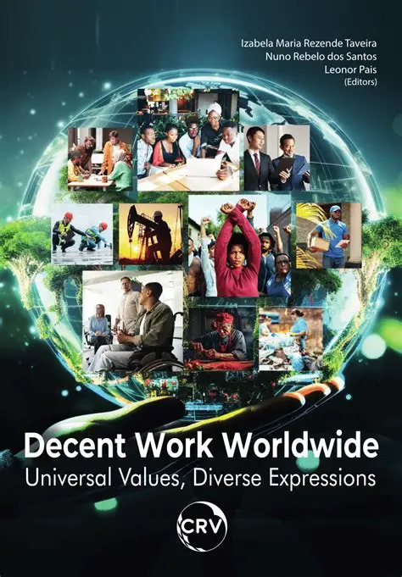
Taveira, I., dos Santos, N. R. & Pais, L. (Eds) (2023). Decent work worldwide: universal values, diverse expressions. Brazil, Curitiba: CRV publishers. https://doi.org/10.24824/978652515852.5

Slide 10
C190 – definitions - Article 1
  (a) the term “violence and harassment” in the world of work refers to a range of unacceptable behaviours and practices, or threats thereof, whether a single occurrence or repeated, that aim at, result in, or are likely to result in physical, psychological, sexual or economic harm, and includes gender-based violence and harassment;
  (b) the term “gender-based violence and harassment” means violence and harassment directed at persons because of their sex or gender, or affecting persons of a particular sex or gender disproportionately, and includes sexual harassment.

Slide 11
GBVH & Decent Work
DW1: trust, justice, non-discrimination, freedom to express ideas related to decisions that affect individual life, participation, dignity
      Deshpande, J. (2025). Creating a Safer Tomorrow: Addressing Workplace Violence Against Women in Healthcare Settings. The Journal of Obstetrics and Gynecology of India, 1-3.
      Garro, Maria, Rubinia Celeste Bonfanti, Adriana Argento, and Stefano Ruggieri (2024). Violence Against Men and Its Effects within the Workplace: A Literature Review. Social Sciences 13: 636. https:// doi.org/10.3390/socsci13120636
DW2: time to rest, workload, shifts, work/no-work life
      Meschitti, V. (2025). On the persistence of gender inequality: the case of informal workload allocation in a research-intensive university in the UK. Culture and Organization, 1–25. https://doi.org/10.1080/14759551.2025.2509249
      Tomer, G., Xanthakos, S., Kim, S., Rao, M., Book, L., Litman, H. J., & Fishman, L. N. (2015). Perceptions of gender equality in work–life balance, salary, promotion, and harassment: Results of the NASPGHAN Task Force Survey. Journal of Pediatric Gastroenterology and Nutrition, 60(4), 481-485.

Slide 12
GBVH & Decent Work
DW3: fulfilling and productive work
      Pradhan, S., & Jena, L. K. (2017). Effect of abusive supervision on employee’s intention to quit and the neutralizing role of meaningful work in Indian IT organizations. International Journal of Organizational Analysis, 25(5), 825-838.
      Sari, R. D., & Dudija, N. (2024). The impact of toxic workplace environments on employee productivity: A systematic literature review. International Journal of Science, Technology & Management, 5(4), 878-882.
DW4: remuneration for being a full citizen in society
      Stasenko, M., Tarney, C., Seier, K., Casablanca, Y., & Brown, C. L. (2020). Sexual harassment and gender discrimination in gynecologic oncology. Gynecologic oncology, 159(2), 317-321. https://doi.org/10.1016/j.ygyno.2020.08.014

Slide 13
GBVH & Decent Work
DW5: social protection in vulnerable conditions
    Cookson, T. P., Fuentes, L. & Bitterly, J. (2025). Addressing gender-based violence through social protection: a scoping review. Development in Practice, 35(3), 305-320. https://doi.org/10.1080/09614524.2023.2290438
DW6: developmental opportunities
    King, E. B., Botsford, W., Hebl, M. R., Kazama, S., Dawson, J. F., & Perkins, A. (2010). Benevolent Sexism at Work: Gender Differences in the Distribution of Challenging Developmental Experiences. Journal of Management, 38(6), 1835-1866. https://doi.org/10.1177/0149206310365902 (Original work published 2012)
    Taparia, M., & Lenka, U. (2022). An integrated conceptual framework of the glass ceiling effect. Journal of Organizational Effectiveness: People and Performance 22 July 2022; 9 (3): 372–400. https://doi.org/10.1108/JOEPP-06-2020-0098
DW7: health and safety at work
    Cox, R. (2024). Addressing gender-based violence and harassment in a work health and safety framework (No. 116). ILO Working Paper.
    Blindow, K. J., Cedstrand, E., Elling, D. L., Hagland, M., & Bodin, T. (2024). Gender-based violence and harassment at work and health and occupational outcomes. A systematic review of prospective studies. BMC Public Health, 24(1), 1788.

Slide 14
DW7 – Health and Safety
GBVH as a psychosocial risk that affects the occupational health of the targets
  Cox, R. (2024). Addressing gender-based violence and harassment in a work health and safety framework (No. 116). ILO Working Paper.
  Blindow, K. J., Cedstrand, E., Elling, D. L., Hagland, M., & Bodin, T. (2024). Gender-based violence and harassment at work and health and occupational outcomes. A systematic review of prospective studies. BMC public health, 24(1), 1788.

Slide 15
THANK YOU!
Nuno Rebelo dos Santos & Leonor Pais

