Slide 1


Slide 2



From Insight to Impact New Directions in Sexual Harassment Research Expert seminar,
Bratislava, 16. – 17. September 2025

Slide 3

Why gender-based violence data?
To estimate the prevalence of gender-based violence across the European Union based on population survey
The EU gender equality strategy 2020-2025
Need for regular data collection highlighted in:
Istanbul Convention, EU joined in 2023
The Directive 2024/1385 on combating violence against women and domestic violence
Notes:
The aim of Violence Against Women (VAW) surveys is to provide comprehensive data that forms the foundation for developing effective strategies to combat gender-based violence. These surveys help increase societal awareness by shedding light on the prevalence and impact of violence against women, promoting a deeper understanding of its root causes and consequences. Moreover, they serve as a vital tool for advocating greater accountability from states and policymakers, urging them to take decisive actions in addressing and preventing such violence. By gathering reliable data, these surveys contribute to creating informed and targeted interventions, ultimately fostering safer environments for women and holding governments responsible for their commitments to end gender-based violence.
Information needed by policymakers and advocates may include the number of women affected by various types of violence and the short- and long-term consequences thereof, the personal characteristics that leave certain women particularly vulnerable to victimization, the barriers to seeking help and the responses of criminal justice, health and social services to women who seek help.
Women in the population are interviewed about their experiences of violence and additional information, such as on the circumstances of the violence, the health consequences thereof and the actions they took to seek help can easily be collected

Slide 4
EU-GBV survey timeline
2016
Eurostat Working Group on Crime Statistics establishes the Task Force to develop the survey
2017
2019
Preparing the survey methodology including questionnaire, testing and piloting the questionnaire and survey
Data collection on voluntary bases: in 19 Member States coordinated by Eurostat and in 8 Member States coordinated by FRA/EIGE
2020
2024
Data dissemination: data on Member States' level in baches as finalised
Joint dissemination of EU-wide data: Key results report
EU gender-based violence survey - Publications Office of the EU
2022
2025
2024
2026
Preparation of regular EU-GBV survey, next wave to be implemented in 2027 and to be repeated every 5 years

Slide 5
METHODOLOGY OF THE SURVEY

Slide 6

Preparing at national level
Common guidelines disseminated by Eurostat
National experts on statistics, gender equality and gender-based violence – included in the team
Interviewers' selection and training – specific requirements
Focus on specific topics as confidentiality, ensuring safety of interviewer and respondent, providing information on support services
Selecting the most appropriate data collection method
Notes:
The aim of Violence Against Women (VAW) surveys is to provide comprehensive data that forms the foundation for developing effective strategies to combat gender-based violence. These surveys help increase societal awareness by shedding light on the prevalence and impact of violence against women, promoting a deeper understanding of its root causes and consequences. Moreover, they serve as a vital tool for advocating greater accountability from states and policymakers, urging them to take decisive actions in addressing and preventing such violence. By gathering reliable data, these surveys contribute to creating informed and targeted interventions, ultimately fostering safer environments for women and holding governments responsible for their commitments to end gender-based violence.
Information needed by policymakers and advocates may include the number of women affected by various types of violence and the short- and long-term consequences thereof, the personal characteristics that leave certain women particularly vulnerable to victimization, the barriers to seeking help and the responses of criminal justice, health and social services to women who seek help.
Women in the population are interviewed about their experiences of violence and additional information, such as on the circumstances of the violence, the health consequences thereof and the actions they took to seek help can easily be collected

Slide 7
Data collection
Representative sample in each country, minimum effective sample size agreed
Focus on women aged 18-74; 11 Member States covered total population
Data collection methods: with interviewer (CAPI or CATI) or web-interview (CAWI) and for most sensitive sections' possibility for self-completion recommended
Support to interviewers and respondents (depending data collection method)
Notes:
The aim of Violence Against Women (VAW) surveys is to provide comprehensive data that forms the foundation for developing effective strategies to combat gender-based violence. These surveys help increase societal awareness by shedding light on the prevalence and impact of violence against women, promoting a deeper understanding of its root causes and consequences. Moreover, they serve as a vital tool for advocating greater accountability from states and policymakers, urging them to take decisive actions in addressing and preventing such violence. By gathering reliable data, these surveys contribute to creating informed and targeted interventions, ultimately fostering safer environments for women and holding governments responsible for their commitments to end gender-based violence.
Information needed by policymakers and advocates may include the number of women affected by various types of violence and the short- and long-term consequences thereof, the personal characteristics that leave certain women particularly vulnerable to victimization, the barriers to seeking help and the responses of criminal justice, health and social services to women who seek help.
Women in the population are interviewed about their experiences of violence and additional information, such as on the circumstances of the violence, the health consequences thereof and the actions they took to seek help can easily be collected

Slide 8
WHERE TO FIND DATA

Slide 9
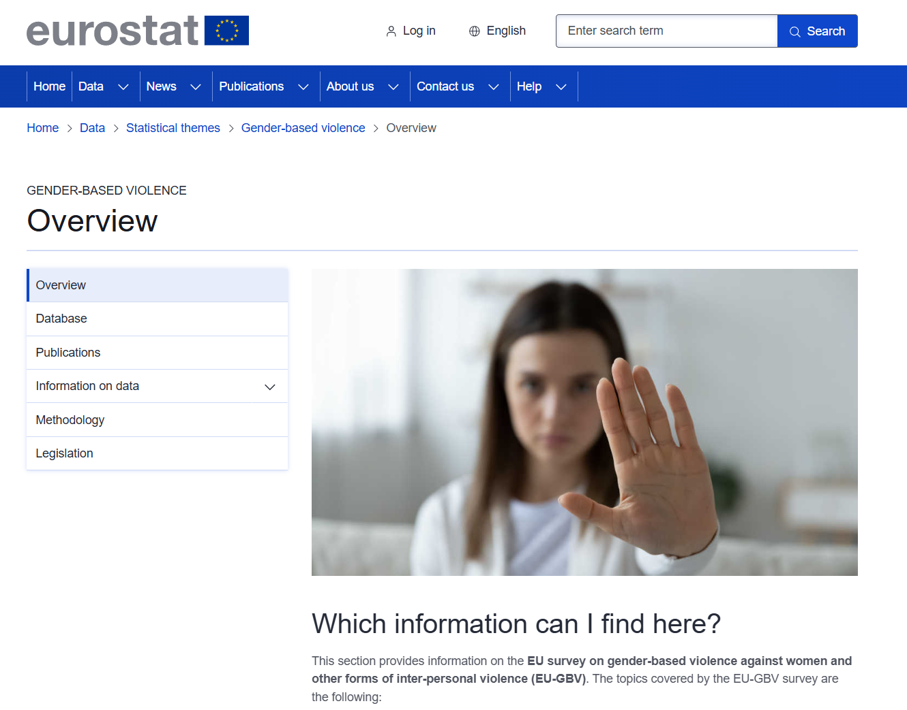
Direct link to the data tables and metadata
Publications: methodological guidelines and main results; podcast on collecting the data on gender-based violence
Main concepts and definitions used in the EU-GBV survey

Slide 10
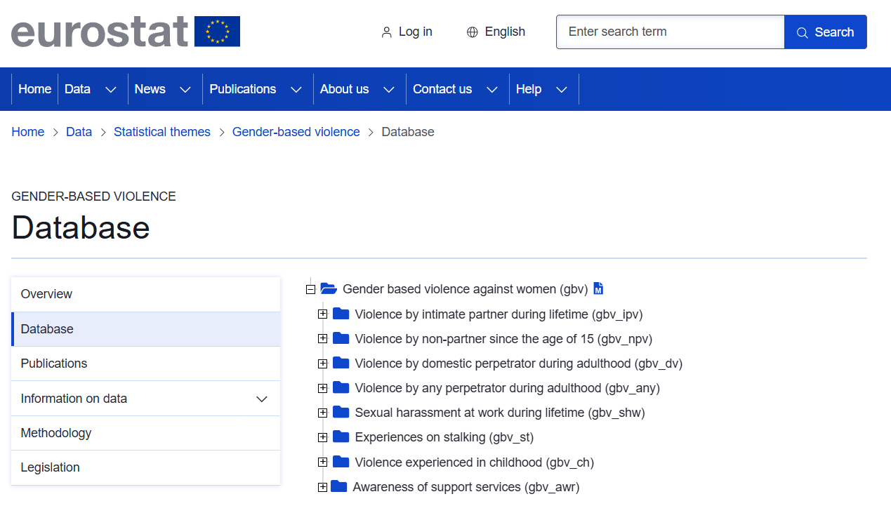

Minimum list of disseminated indicators agreed in the EU-GBV TF
Metadata:
Description of data and indicators
Sample, fieldwork, data collection method, response rate
Short/Full version available:
Main data tables for each topic

Slide 11
KEY RESULTS

Slide 12
SURVEY TOPICS AND INDICATORS
Proportion of women in the last 12 months/5 years/lifetime…
Type of violence
Type of perpetrator
Context of violence
Physical (including threats)
Sexual (including rape)
Psychological (*economic)
Other:
sexual harassment at work, childhood experiences, stalking.
Intimate Partner Violence
Domestic perpetrator violence (intimate partner, relative; or any other person living in the same household at the time of violence)
Non-partner violence
Reporting
Awareness of support services
Impact and consequences of violence
Characteristics of women (level of education, disability, age, etc.)
Notes:
The reference time of experienced violence is divided into the last 12 months, 1-5 years ago or earlier than 5 years ago. Data covering experiences over the last year and the last five years can give an indication of the extent and
the nature of current levels of violence and an estimate of the number of people who may require help. Lifetime experiences, by contrast, provide an indication of the total number of people ever affected by such forms of
Violence.
Intimate partners are persons with whom a victim has or had an intimate relationship:
• current or former spouses
• civil union partnaers or cohabitants
• people in an informal relationship or who are dating
• people whose marriage has been dissolved or declared null
• people who have been engaged, formally or informally, to get married or enter a civil partnership
Non-partners are all other perpetrators with whom a victim does not have or has never had an intimate relationship.
The EU-GBV survey asks the sex of the perpetrator for each type of perpetrator, and the relationship between victim and perpetrator is classified according to the following types of perpetrators:
• relative: in the case of violence experienced in childhood, this type is divided up as follows: father or father f igure, mother or mother figure, brother or half-brother, sister or half-sister, and other relative
• friend
• professional: in cases involving adult victims, this type is divided up as follows: supervisor, boss, professor, teacher; person with authority or privileged status: army or police officer, religious leader, doctor
• any other person known to the victim: colleague, neighbour, family friend, acquaintance
• stranger
The term ‘domestic perpetrator’, as used in the EU-GBV survey, includes family members and other individuals living or having lived in the same household as the victim at the time of one or more violent events.
They also include intimate partners as perpetrators.
Violence experienced in childhood covers, first, violence perpetrated by parents, such as belittling or humiliating
a child verbally or serious physical violence (intentional hitting, kicking, beating with an object like a stick or a belt,
burning or stabbing). Second, it covers sexual violence perpetrated against any person before the age of 15.
Violence experienced in adulthood covers violence experienced by a non-partner since the age of 15 and
intimate partner violence during a person’s lifetime.

Slide 13
WOMEN ACROSS THE EU EXPERIENCE VIOLENCE
IN ALL AREAS OF LIFE

Slide 14
STILL ONE IN THREE
Women experiencing physical violence or threats, and/or sexual violence by any perpetrator, adulthood (%)
1 in 3 women in EU-27 have experienced physical violence or threats, and/or sexual violence in their lifetime.
Notes:
In the EU-27, 30.7 % of women have experienced physical violence or threats and/or sexual violence by any perpetrator over their lifetime. In the context of these results, experiences of violence by ‘any perpetrator’ refer to violence perpetrated by a woman’s intimate partner (current partner or any previous partner) and by people who were not an intimate partner (non-partners). This includes both male and female perpetrators. Across Member States, the prevalence of such violence ranges from 57.1 % in Finland, 52.5 % in Sweden and 49.1 % in Hungary to under 20 % in Czechia and Portugal (both 19.7 %), Poland (16.7 %) and Bulgaria (11.9 %)
The act of physical violence in the EU-GBV questionnaire refers to violent behaviour in which harm and fear must be included. Bodily injury is any physical impairment, pain, or illness. Minor physical force The following variables refer to experiences of minor physical force, including acts leading to or intending to cause harm (acts committed on purpose), i.e. minor bodily injury, but not intending to cause death. Such acts are hitting, slapping, kicking, pushing, tripping, knocking down or drugging the victim, or spiking the victim’s drink. The accent in these variables is on ‘feeling frightened’ or ‘being hurt’ and ‘on purpose’, so this wording should be part of the question

Slide 15
SEXUAL MORE THAN PHYSICAL
17.2% of women in the EU (approximately 1 in 6) have experienced sexual violence over their lifetime.​
Notes:
Countries vary in the type of violence that women most commonly mentioned in the survey. In some of the countries with the highest overall prevalence of violence, the rate of sexual violence experienced by women is high: 41.0 % of women in Sweden, 37.3 % in Finland, 33.3 % in Denmark, 30.0 % in Luxembourg and 28.6 % in the Netherlands. However, in Hungary, which is also among the countries with the highest overall prevalence, the rate of physical violence and/or threats (31.2 %) is higher than that of sexual violence (17.9 %)
While the lifetime prevalence of physical violence and/or threats (no sexual violence) varies between 31.2 % and 8.5 % across the EU-27 depending on the country (EU-27 average: 13.5 %), there is more variation in the prevalence of sexual violence, from 41.0 % to 3.4 % (EU-27 average: 17.2 %).

Slide 16
Violence by Intimate Partners
Women experiencing physical violence or threats, sexual violence or psychological violence by intimate partners, lifetime rate (%)
5.1 % of women in EU-27 have experienced stalking by an intimate partner.
Notes:
In the EU-27, 17.7 % of women have experienced physical violence or threats and/or sexual violence over the course of their lives by an intimate partner. The prevalence rate of lifetime intimate partner violence is higher – 31.8 % – when psychological violence is included.
In the context of the survey, intimate partners include a partner by marriage, civil union or registered partnership or another person with whom the respondent is in a relationship. The latter can include intimate partners who are or are not living with the respondent (e.g. dating partners). It includes the respondent’s current partner and any former partners, male or female.
The results presented refer to the experiences of women who had an intimate partner at the time of the survey (current partner) or had an intimate partner in the past (former partner). The lifetime rate of intimate partner violence (physical violence or threats, sexual violence and/ or psychological violence) ranges from 54.6 % in Hungary, 52.6 % in Finland and 50.8 % in Slovakia to 22.5 % in Portugal, 20.5 % in Bulgaria and 19.6 % in Poland. For a majority of women who experience physical violence or threats and/or sexual violence by their intimate partner, this involves repeated incidents of violence. Overall, 14.6 % of women in the EU indicate that they have experienced this more than once, while 3.5 % noted in the survey that it was a single incident.
Alongside questions about intimate partners – including obsessive and controlling behaviours – the survey asked women whether they had experienced stalking, which was defined for the purposes of the survey as experiences that took place repeatedly and caused women fear, alarm or distress. In total, 5.1 % of women in the EU-27 have experienced stalking by an intimate partner in their lifetime.

Slide 17
Violence at Home
Women experiencing physical violence or threats and sexual violence by domestic partners, lifetime rate (%)
Approximately 1 in 5 women in the EU have experienced physical violence or threats and/or sexual violence by a domestic perpetrator (intimate partner, relative or person in the same household) over their lifetime. ​
Prevalence in different member states ranges from 9.5% to 43.8%.
Notes:
VIOLENCE PERPETRATED BY DOMESTIC PERPETRATORS In addition to experiencing violence perpetrated by an intimate partner (violence that often takes place at home), 4 % of women in the EU have experienced physical violence or threats and/ or sexual violence perpetrated by a family member or relative in their lifetime. Taking into account violence perpetrated by domestic perpetrators – this includes intimate partners and relatives, as well as other people living in the same household when the violence took place – one in five women in the EU (19.3 %) have experienced physical violence or threats and/or sexual violence by a domestic perpetrator in their lifetime.

Slide 18
Violence by a non-partner
Experiences of physical violence or threats, and/or sexual violence by non-partners, lifetime rate (%)
3.8 % of women in EU-27 have been raped during their life by someone other than their intimate partner.
Notes:
Violence happens both in intimate relationships and outside them. Threatening, physical violence or sexual violence perpetrated by someone such as a stranger, an acquaintance, a friend, a colleague, a teacher, a neighbour or a family member, and which happened since the age of 15, is referred to as non-partner violence.
Among women in the EU-27, 20.2 % have experienced physical violence or threats and/or sexual violence since the age of 15 by a perpetrator other than their intimate partner. — Among women in the EU-27, 12.9 % have experienced sexual violence (including rape) by a perpetrator other than their intimate partner since the age of 15. Specifically, 3.8 % of women in the EU have been raped since they were 15 years old by someone other than their intimate partner.
Across Member States, this percentage ranges from 46.5 % in Finland, 42.0 % in Sweden and 38.2 % in Denmark to less than 10 % of women in Czechia, Poland and Bulgaria.

Slide 19
Sexual violence and sexual harassment at work
In EU-27, 30.8 % of women have experienced sexual harassment during their working life.
Notes:
One in three women in the EU-27 (30.8 %) have experienced sexual harassment at work in their lifetime. — The rate of sexual harassment at work is higher (41.6 %) among women in the youngest age group in the survey (18–29 years) than in other age groups. — In a majority of cases, the perpetrator of sexual harassment was a man. Among women in the EU-27, 15.8 % have experienced sexual harassment by a male coworker, 7.4 % by a male boss or supervisor and 9.3 % by another man in the work context (e.g. a client or customer).
Across Member States, the percentage of women who have experienced sexual harassment at work in their lifetime ranges from 55.4 % in Sweden, 53.7 % in Finland, 53.0 % in Slovakia and 52.9 % in Luxembourg to 12.3 % in Portugal, 12.2 % in Bulgaria and 11.0 % in Latvia.

Slide 20
PERPETRATORS
OF VIOLENCE

Slide 21
Violence by type of perpetrator
Women experiencing physical violence or threats, and/or sexual violence, lifetime rate (%)

Slide 22
Violence by non-partners
Women experiencing physical violence or threats, and/or sexual violence by non-partners, EU-27 (%)
Male perpetrators of non-partner violence, out of all EU-27 women (%)
Notes:
Careful: the base for calculation here is ALL EU women (not victims, not perpetrators).

Slide 23
Comparing types of perpetrators
Women in the EU-27 who have experienced violence, by type of perpetrator and type of violence (excluding/including sexual violence (%)

Slide 24
ACROSS THE UNION, GENDER-BASED VIOLENCE REMAINS MOSTLY INVISIBLE TO THE AUTHORITIES

Slide 25
AWARENESS IS NOT ENOUGH, SAFE SPACES
NEEDED
Awareness of official support services varies greatly from country to country.​ Overall, 74.3% of victims in the EU are aware of the existence of support services. However, the rate of contacting these services remains lower than what might be expected.
Overall, 68.2% of women reported the violence experienced to a close person or a service. Only 26.7% of women reported it to health, social or support services or the police. A third of women (31.8%) still had not shared their experiences with anyone – before the survey.
Notes:
Across the EU, 63.7 % of women indicated that they talked to a person close to them such as a friend, family member or relative. Besides informal support, 20.5 % of women indicated that they contacted a healthcare service or social service provider, 13.9 % reported the incident to the police and 6.4 % contacted a helpline or victim support service. This shows that most incidents of violence do not come to the attention of the police and other service providers, and many victims and survivors have to cope with their experiences without professional support. As a result, victims may not be fully informed of their rights and the support available to them
Awareness of official support services varies greatly from country to country.
74,3% of victims in the EU are aware of the existence of support services, but only 26,7% reported violence to a health, social or support service or police.

Slide 26
Reporting and support
Women victims reporting and contacting authorities, EU-27 (%)
Incidence of physical violence or threats, and/or sexual violence experienced by women, EU-27 (%)

Slide 27
Awareness of availability of support
Awareness of existing support services among women who have experienced physical violence or threats, and/or sexual violence by any perpetrator (%)
1 in 4 victims in EU-27 are not aware of the support services available in their country

Slide 28
INTERSECTIONAL ASPECTS AND THE HIGHER RISKS FACED BY YOUNG WOMEN

Slide 29

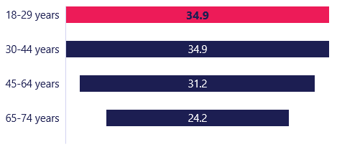
WOMEN WHO HAVE EXPERIENCED VIOLENCE BY ANY PERPETRATOR
BY AGE GROUP
Prevalence seems to be lower for women 65-74 years old.​ Younger women disclosed a high rate of violence, especially in MS where the overall prevalence is high.​
BY EDUCATION
Women with tertiary education disclosed more non-partner violence. Intimate partner and domestic violence prevalence resulted similar across different education levels.
Notes:
Across the EU, violence is generally lower for older women (65-74): 24.2% of women.
Younger women (18-29) in the EU report a high prevalence of violence, especially in countries where overall prevalence is high. The most prevalent is Stalking where more than 28,3 of the victims of staking are between 18 and 29 years old.
Intimate partner violence and domestic violence is similar across education levels.
Women with tertiary education experience more non-partner violence (25.4%).
IPV is highest for all settings.
In towns and suburbs and rural areas, violence is lowest for non-partners.
In cities, however, the proportion of women experiencing non-partner violence is similar to domestic violence.

Slide 30
OTHER RELEVANT SOURCES AND ACTIVITIES ON THE TOPIC

Slide 31

Annual crime data collection
Data on police recorded crime offences provided voluntary, joint data collection with Eurostat and UNODC
Data on trafficking of human beings (THB) required in the Directive 2011/36/EU
Relevant data disseminated by Eurostat:
Intentional homicide victims by victim-offender relationship and sex (crim_hom_vrel)
Victims of intentional homicide and sexual exploitation by age and sex (crim_hom_vage)
Persons involved in trafficking in human beings by legal status and sex (crim_thb_sex)

Slide 32
EIGE’s Administrative data collection on VAW
Administrative data as a crucial tool to monitor violence against women.
EIGE created 13 refined indicators on data about violence against women from the police and justice sectors.
Police sector
Justice sector
Indicator 1 | Annual number of [female and total] victims of [intimate partner/domestic/any] violence, as recorded by the police
Indicator 2 | Annual number of reported offences of [intimate partner/domestic/any] violence against [female and total] victims, as recorded by the police
Indicator 3 | Annual number of male perpetrators of [intimate partner/domestic/any] violence against [female and total] victims, as recorded by the police
Indicator 4 | Annual number of [female and total] victims of [intimate partner/domestic/any] physical violence, as recorded by the police
Indicator 5 | Annual number of [female and total] victims of [intimate partner/domestic/any] psychological violence, as recorded by the police
Indicator 6 | Annual number of [female and total] victims of [intimate partner/domestic/any] sexual violence, as recorded by the police
Indicator 7 | Annual number of [female and total] victims of [intimate partner/domestic/any] economic violence, as recorded by the police
Indicator 8 | Annual number of [female and total] victims reporting [intimate partner/domestic/any] rape, as recorded by the police
Indicator 9 | Annual number of [female and total] victims of [intimate partner/domestic/any] [femicide/homicide], as recorded by the police
Indicator 10 | Annual number of protection orders [applied for and granted] in cases of [intimate partner/domestic/any] violence against [female and total] victims
Indicator 11 | Annual number of male perpetrators prosecuted for [intimate partner/domestic/any] violence against [female and total] victims
Indicator 12 | Annual number of male perpetrators sentenced for [intimate partner/domestic/any] violence against [female and total] victims
Indicator 13 | Number of male perpetrators held in prison or with a sanction involving a form of deprivation of liberty for [intimate partner/domestic/any] violence against [female and total] victims
Notes:
Administrative data consist of statistics and information gathered from institutions that come into contact and interact with victims and/or perpetrators of violence against women (mainly the police, justice, health and social services). It therefore provides valuable information on the use of public services by victims as well as the performance and response of the system to the problem. Although administrative data is primarily used for the internal purposes of the institutions gathering the information, it is increasingly being utilised for statistical purposes mainly due to the increasing demand for data enabling the monitoring and evaluation of government programs and policies - and a wide range of administrative sources are employed in many ways in the production of statistics.
In 2023, EIGE published a refined methodology and indicators in preparation for the next collection of intimate partner violence, rape and femicide data. Given the lack of disaggregated data on intimate partner violence in the EU, EIGE refined its methodology to accommodate the collection of data on domestic violence, which would help to account for variations in legal approaches to defining intimate partner violence. Collecting data on domestic violence also aligns with EIGE’s future data collection exercise in line with what set out in Article 44 of Directive 2024/1385 on combating violence against women and domestic violence (EIGE, 2023b).
This study is one of EIGE’s several initiatives to improve the current situation of administrative data collection on violence against women in the EU. It provides the results of EIGE’s second data collection exercise, which ran between 2023 and 2024, and analyses the current state of data collection in the police and justice sectors on intimate partner violence, domestic violence, rape and femicide across 26 EU Member States (), analysing the state of play in populating the refined indicators, identifying key data gaps and proposing recommendations to overcome them. Slovakia did not participate to the data collection exercise.

Slide 33
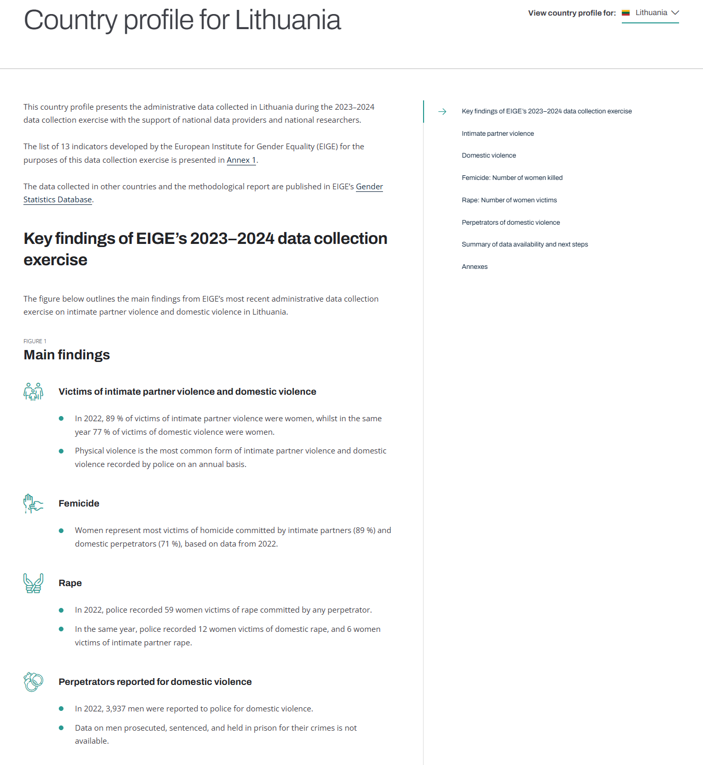
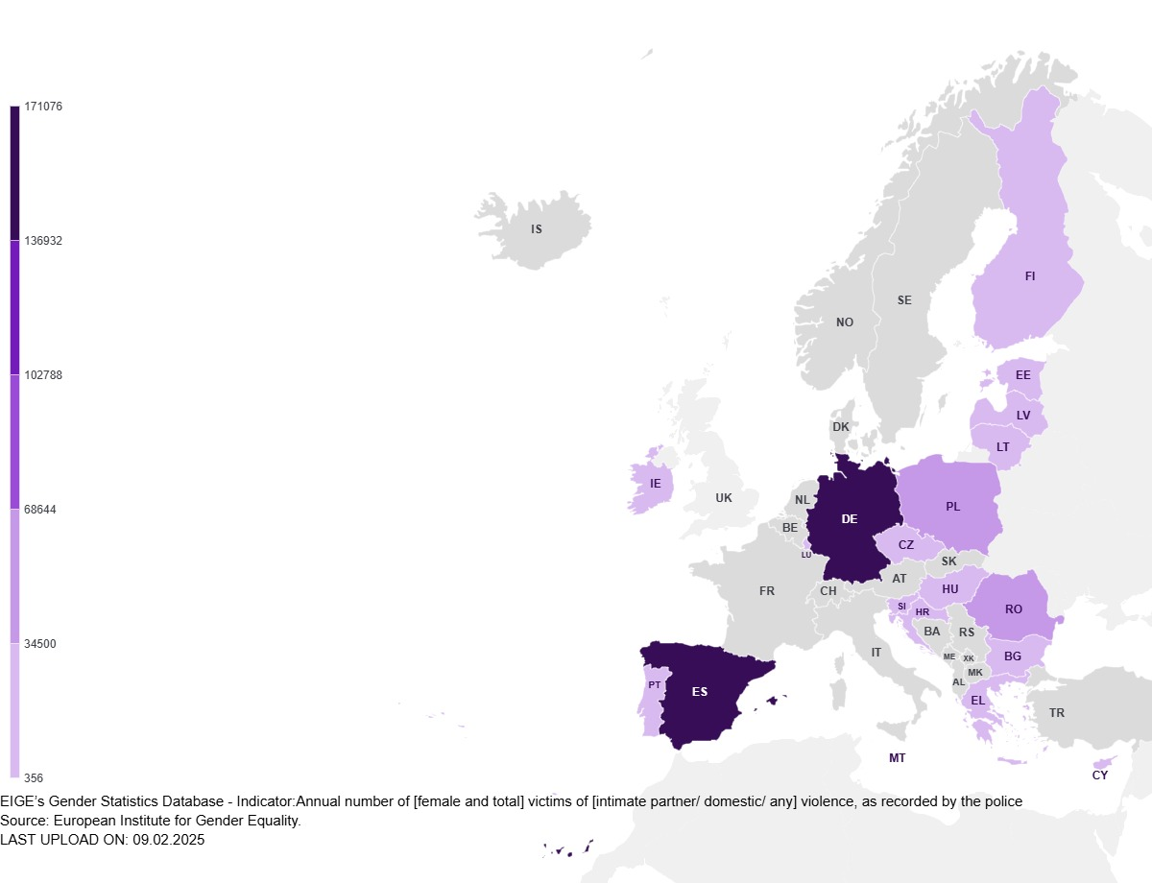
EIGE’s Administrative data collection on VAW
Collected data from 26 MS during 2023-2024.
Data were presented in individual country profiles and absolute number maps due to problems with comparability.
Methodological and analytical report forthcoming, as well as a policy brief on the importance of administrative data collection.
This project will be essential to the implementation of Article 44 on data collection of the EU Directive on combatting VAW and DV.
Country profile
Annual number of female victims of domestic violence in 2022, as recorded by the police
Maps
Notes:
In 2023, EIGE published a refined methodology and indicators in preparation for the next collection of intimate partner violence, rape and femicide data. Given the lack of disaggregated data on intimate partner violence in the EU, EIGE refined its methodology to accommodate the collection of data on domestic violence, which would help to account for variations in legal approaches to defining intimate partner violence. Collecting data on domestic violence also aligns with EIGE’s future data collection exercise in line with what set out in Article 44 of Directive 2024/1385 on combating violence against women and domestic violence (EIGE, 2023b).
This study is one of EIGE’s several initiatives to improve the current situation of administrative data collection on violence against women in the EU. It provides the results of EIGE’s second data collection exercise, which ran between 2023 and 2024, and analyses the current state of data collection in the police and justice sectors on intimate partner violence, domestic violence, rape and femicide across 26 EU Member States (), analysing the state of play in populating the refined indicators, identifying key data gaps and proposing recommendations to overcome them. Slovakia did not participate to the data collection exercise.

Slide 34
Selected FRA activities
Survey results to be published in 2025
Violence against women displaced by the war in Ukraine
Experiences of hate-motivated violence, harassment and discrimination among LGBTIQ, Roma, immigrants and descendants of immigrants
Report on online content moderation, based on data collected on online harassment, hate speech and (incitement to) violence – including misogynist content; planning for further data collection
Report on violence against persons with disabilities in institutions

Slide 35
THANK YOU

