Slide 1
Using EU GBV survey insights & comms tools to address sexual harassment at work
Alexandrina Satnoianu | Campaigns Coordinator
16 September 2025

Slide 2



Sexual harassment at work – EU GBV Survey campaign milestone

Slide 3





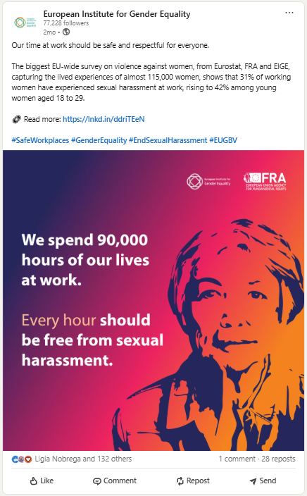
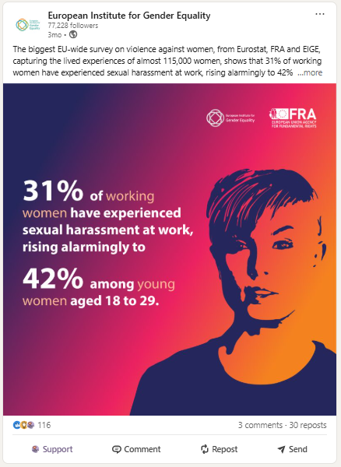






Sexual harassment at work communications approach: Problem – Solution - Hope
Messages – target audience - calls to action
EU GBV Survey SHW findings
NEWS ITEM
Social media posts
Consultation meetings / online questionnaire

Slide 4





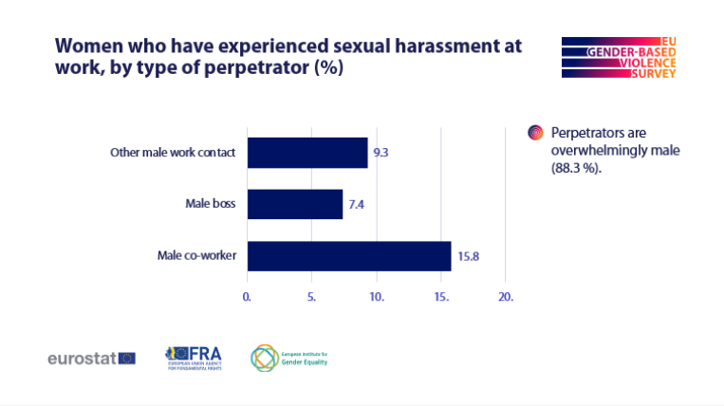

Sexual harassment at work communications approach: Problem – Solution - Hope
Messages – target audience - calls to action
EU GBV Survey SHW findings
Social media posts
NEWS ITEM
Consultation meetings / online questionnaire
Employers’ package
POSTER
SLIDE DECK
MESSAGES & VISUALS

Slide 5
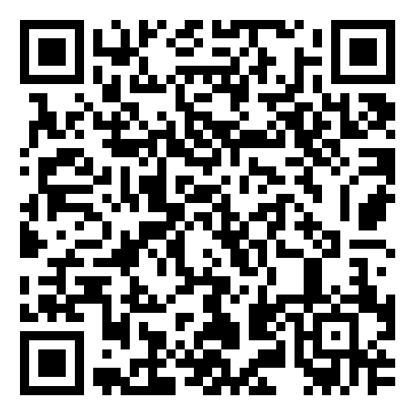
ONLINE QUESTIONNAIRE ADDRESSED
TO EUROCHAMBERS / EUROCOMMERCE
✓
✓
✓
Prevalence data would convince
employers to act
Target managers / HR offices / trade union representatives
Training for HR / for supervisors would be considered useful
✓
✓
Good practices / materials / support for HR managers
would be of help
Slide deck / posters / messages would be useful awareness-raising materials

Slide 6

31 % OF WOMEN ARE VICTIMS OF SEXUAL HARASSMENT AT WORK.
IT SHOULD BE ZERO.
EMPLOYERS HAVE THE POWER TO CHANGE IT.
EVERY WOMAN DESERVES TO FEEL SAFE.

Slide 7
Disclosing experiences of sexual harassment at work [SHW] is influenced by how societies perceive, define, and talk about violence against women, including sexual harassment.
For this reason, the figures should be seen as an indication, with the actual prevalence likely being higher.
Notes:
A form of discrimination, a human rights violation, a health & safety at work issue, but primarily a gender equality as women are preponderantly affected by it. Although it’s widespread, 90.6 % of women viewed SHW as uncommon.
Prevalence of sexual harassment at work can depend on cultural norms around perceiving, defining, and disclosing violence against women, including sexual harassment.

Slide 8
SOME GROUPS OF WOMEN FACE HIGHER RISKS
OF SEXUAL HARASSMENT AT WORK
115%
54%
Young women, aged 18 to 29*
15%
Women with a tertiary degree*
Women
with a fixed-term contract*
*compared to women aged 65-74
*compared to women with lower education
*compared to women with a permanent contract

Slide 9
SEXUAL HARASSMENT AT WORK IS A GENDER ISSUE DRIVEN BY THOSE MEN WHO FEEL ENTITLED TO SEXUALISE WOMEN.

Slide 10
Unwanted behaviours take different forms, harm victims’ dignity and create a toxic work environment
24.8%
19.1%
13.9%
11.6%
5.3%
Staring or leering
Sexual jokes and remarks
Unwanted physical contact
Inappropriate suggestions for a date
Inappropriate advances on social media
4.4%
3.8%
2%
Sexually explicit emails or messages
Sexually explicit images or videos
Threatening in connotation with sexual harassment

Slide 11
VICTIMS NEED MORE SUPPORT, INCLUDING SAFE-REPORTING

Slide 12
SEXUAL HARASSMENT AT WORK REMAINS INVISIBLE TO THE AUTHORITIES
Women who have experienced sexual harassment at work and have shared their experience, sought support or reported it, EU-27 (%)
Barriers to formal reporting can include:
fear of retaliation
concerns about not
being believed
Not knowing what will happen after reporting, especially for young people, who often have less secure jobs.

Slide 13
EMPLOYERS CAN DRIVE CHANGE

Slide 14

STEPS IN ADDRESSING SEXUAL HARASSMENT AT WORK
Adopt CLEAR POLICIES on what constitutes SHW, how the organisation prevents it from happening, protects employees and deals with perpetrators. RESOURCES are available.
Facilitate SAFE REPORTING with no fear of retaliation – including third-party reporting coming from witnesses.
Commit to a ZERO-tolerance culture – internally, for your employees, but publicly as well, for your clients.

Slide 15
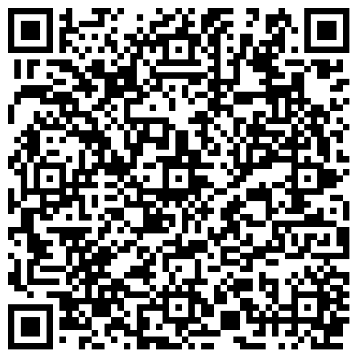
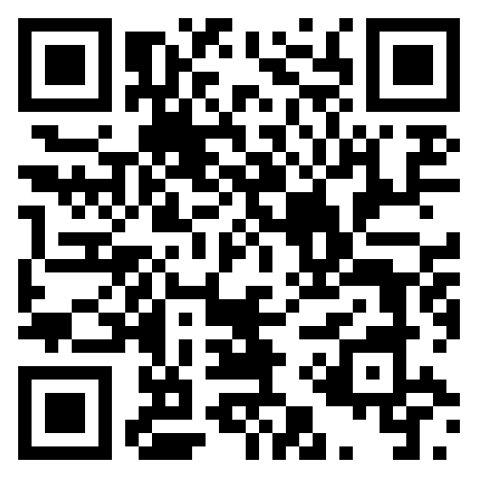
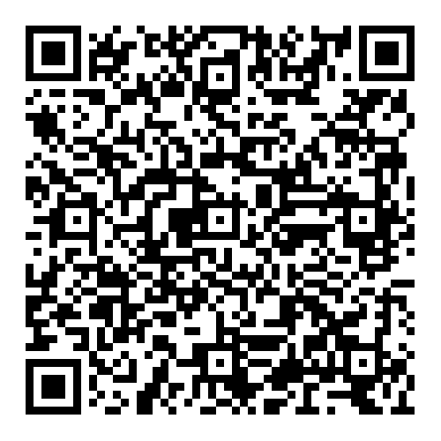
RESOURCES ARE AVAILABLE
EU institutions
EIGE’s Stop Sexism at Work Guide
Businesses
EU-OSHA’s online risk assessment tools help address harassment and violence in the workplace
Universities and research organisations
ERA’ Code of Conduct for Zero Tolerance

Slide 16
Support materials for ZERO tolerance
Dedicated webpage / news item to consult
Social media posts for inspiration
Video to share
COMING SOON
Employers’ package to use
POSTER
SLIDE DECK
MESSAGES & VISUALS

Slide 17


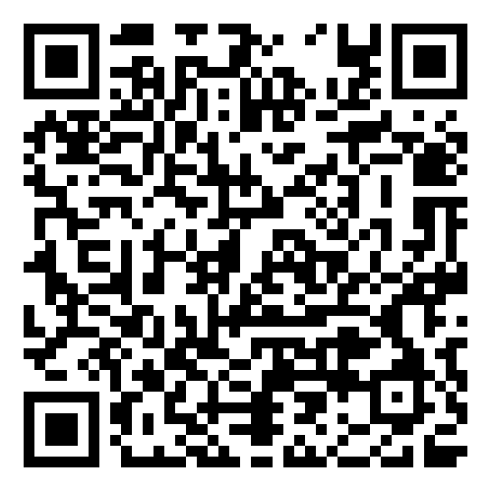






It’s time to reinforce our stand against sexual harassment at work!

